Slide 1
Surrogate ML Accelerator - Electrification Project
Objective
Current State
Bring burstable ML/GPU dense compute capabilities to GEVAR leveraging the AWS cloud - building a scalable solution which can be leveraged as a surrogate model accelerator for the Electrification business
ENG open with CTO/HQ to work with their Solution Architecture team (needed to GWD… called “Base” process
Service Now record for “Business App”
Discussion with AWS to secure P5 instances in planned account
Teams
ARC DT
Mike Russo (Sponsor / Block Breaker)
Todd Shirback (Project Manager)
Dave Garber ( Onprem<>Cloud)
Nam Park (Cloud Engineer – TBD)
Rick Allen (Cloud Engineer – TBD)
Chris Burke (Cloud Engineer – TBD)
Researchers / Business
Jim Tallman
Deepak Akhare
Priyesh Kakka
Next Steps
Kick off call with Jim / Business for intake
Secure funding from business for GPU Servers
Land Servers in destination account
Get Nam / Rick AERO badges to work at 1RC (part-time)
Design of MVP for Jim to GWD
Meetings with CTO/HQ SA/ENG to get GIT pipelines set up for IaC deployments
…etc…
Infrastructure (AWS & Run)
→(4) p5.48xlarge (32 GPUs) instances deployed in an AWS account hosting in the GEV ENT MasterPayer / Org with all Sec / Compliance controls in place (like QB set up)
  Paid for by Electrification 2026 Program $’s
→ Leveraging the QB design as REFERANCE ARCHITECTURE and understanding of how the business is currently leveraging our “on prem” environment to design and build out and environment in the cloud to deliver to ELE needs.

Slide 2
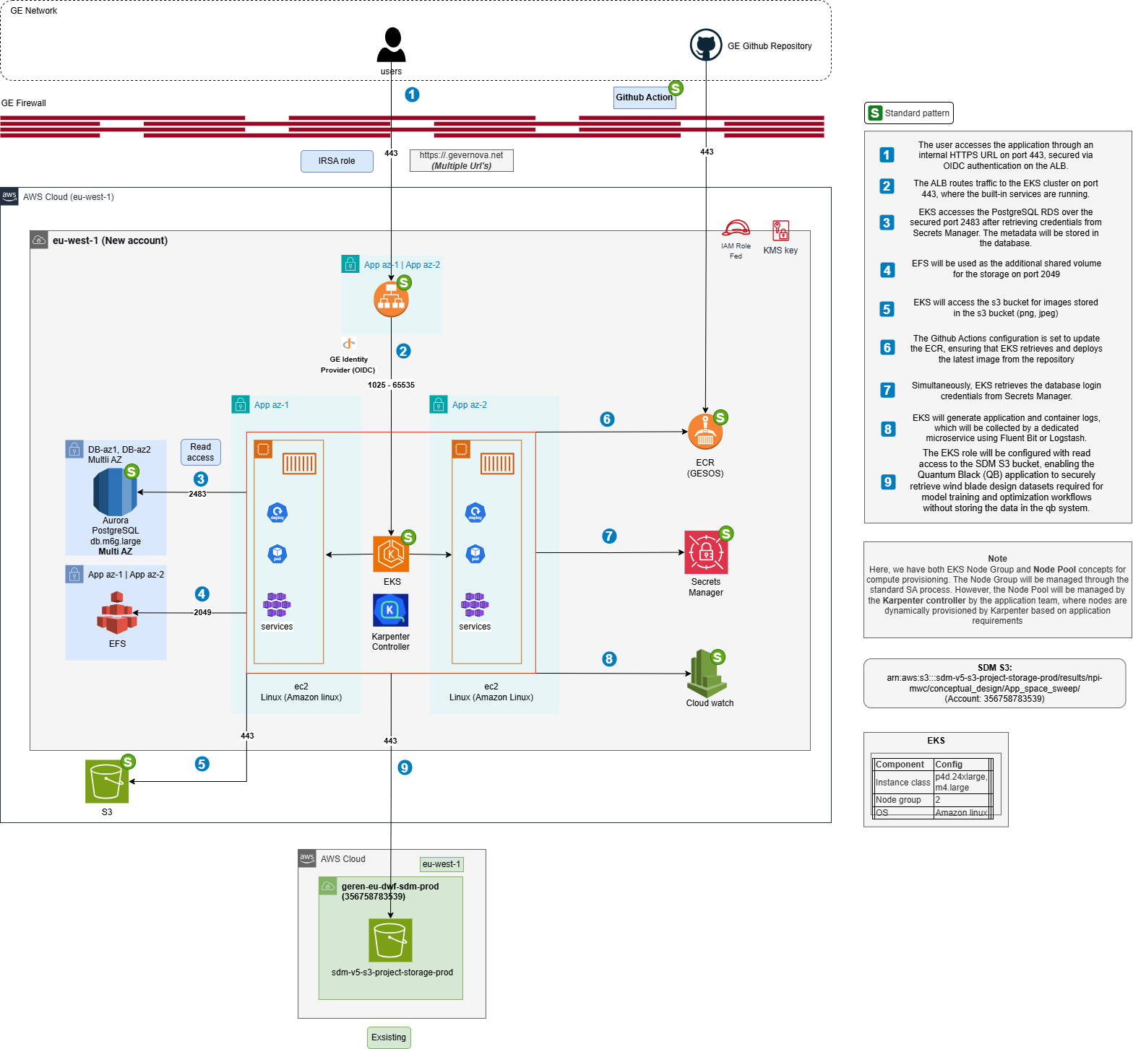
https://confluence.apps.gevernova.net/devspace/pages/viewpage.action?pageId=358862179&spaceKey=VCA&title=GEVDMND0007346%2B-%2BQuantum%2BBlack%2B-%2BPRD

Slide 3
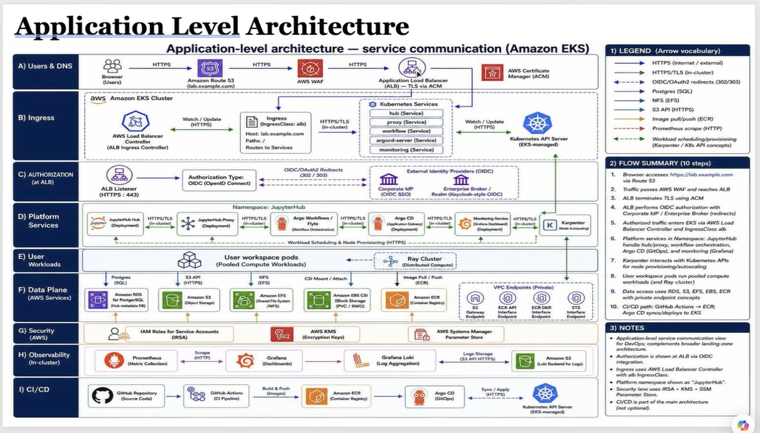

Slide 4
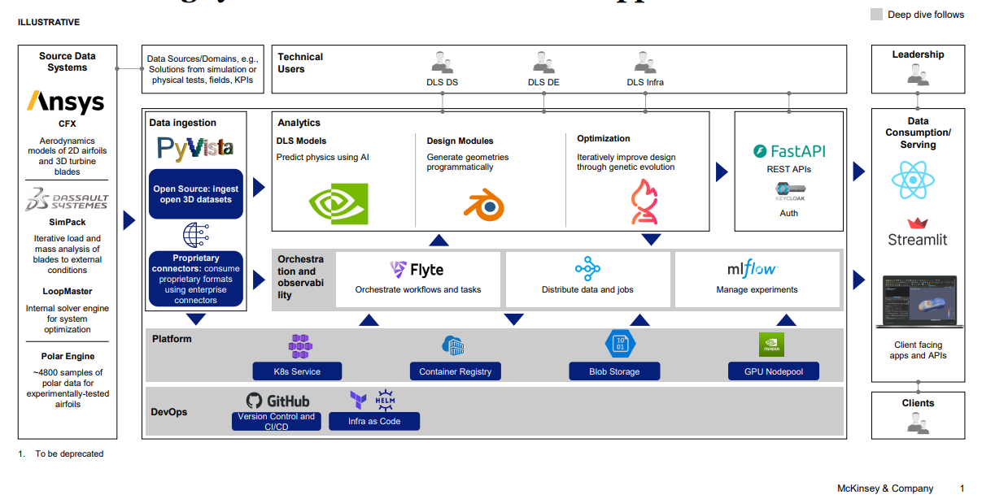

Slide 5
Surrogate ML Accelerator - Electrification Project
Option 1
4 dedicated servers hosted in the GEV AWS environment with 32 Nvidia H100 GPUs leveraging “on-demand” costing model including the GEV Customer discount billed quarterly for 15 months.
Total Cost - $1,832,171.52
Server Count | On-Demand Price | Discount % | Discount | Discounted Price | Duration (months) | Full Cost
4 | $40,179.20 | 24% | $9,643.01 | $30,536.19 | 15 | $1,832,171.52
 |  |  |  |  |  | QTR Cost
 |  |  |  |  |  | $366,434.30
QTRLY Cost - $366,434.30
Option 2
4 dedicated servers hosted in the GEV AWS environment with 32 Nvidia H100 GPUs paid “all up front” (AUF) for a 12-month commitment and 3 additional months at the “on-demand” costing model prices including all GEV Customer discounts
AUF 12-month cost - $ 861,853.48
Server Count | 12 Month (AUF)Price | Discount % | Discount | Discounted Price | Duration (months) | Cost
4 | $1,134,017.74 | 24% | $272,164.26 | $861,853.48 | 12 | $ 861,853.48
Server Count | On-Demand Price | Discount % | Discount | Discounted Price | Duration (months) | Cost
4 | $40,179.20 | 24% | $9,643.01 | $30,536.19 | 3 | $366,434.30
 |  |  |  |  |  | Total Cost
 |  |  |  |  |  | $ 1,228,287.79
3-Month On-Demand cost - $366,434.30
Total Cost - $1,228,287.79
Option 2 saving = $603,883.73

